Slide 1
Lecture 24
Mobile Software Engineering

Slide 2
Introduction
While application development for mobile devices goes back at least 10 years, there has been exponential growth in mobile application development since the iPhone AppStore opened in July, 2008.
Since then, device makers have created outlets for other mobile devices, including Android, BlackBerry, Nokia Ovi, Windows Phone, and more.
Industry analysts estimate that there are more than 250,000 applications available through the various stores and marketplaces, some of which are available for multiple types of devices.
Most of the applications were relatively small, averaging several thousand lines of source code, with one or two developers.
Developers rarely used any formal development processes.

Slide 3
Introduction
Various Programming Environments:-
Apple’s iOS offers the Xcode package, which includes an Interface Builder, an iPhone emulator, and a complete development environment that can be used across all Apple products.
For Android, developers can use the Android Development Tools plug-in for the Eclipse programming environment.
For Windows Phone, developers can use a specialized version of Microsoft’s Visual Studio environment.
Similarly, there are application development tools for BlackBerry, Symbian, and other platforms.

Slide 4
Introduction
These powerful development tools and frameworks greatly simplify the task of implementing a mobile application.
They focused on the individual developer who is trying to create an application as quickly as possible.
They provide principles of abstraction and modularity that are built into the platform architectures.
However, as mobile applications become more complex, it will be essential to apply software engineering processes to assure the development of secure, high-quality mobile applications.

Slide 5
SOFTWARE ENGINEERING in MOBILE APPLICATION DEVELOPMENT
We define “software engineering” as a process by which an individual or team organizes and manages the creation of a software-system, through one or more formal releases.

Slide 6
What Makes Mobile Different?
In many respects, developing mobile applications is similar to software engineering for other embedded applications.
Common issues include integration with device hardware, as well as traditional issues of security, performance, reliability, and storage limitations.
However, mobile applications present some additional requirements that are less commonly found with traditional software applications, including:-

Slide 7
What Makes Mobile Different?
Potential interaction with other applications – Most embedded devices only have factory-installed software, but mobile devices may have numerous applications from varied sources, with the possibility of interactions among them.
Sensor handling – Most modern mobile devices, e.g., “smartphones”, include an accelerometer that responds to device movement, a touch screen that responds to numerous gestures, along with real and/or virtual keyboards, a global positioning system, a microphone usable by applications other than voice calls, one or more cameras, and multiple networking protocols.

Slide 8
What Makes Mobile Different?
3. Native and hybrid (mobile web) applications – Most embedded devices use only software installed directly on the device, but mobile devices often include applications that invoke services over the telephone network or the Internet via a web browser and affect data and displays on the device.
4. Families of hardware and software platforms – Most embedded devices execute code that is custom-built for the properties of that device, but mobile devices may have to support applications that were written for all of the varied devices supporting the operating system, and also for different versions of the operating system.

Slide 9
What Makes Mobile Different?
5. Security – most embedded devices are “closed”, in the sense that there is no straightforward way to attack the embedded software and affect its operation, but mobile platforms are open, allowing the installation of new “malware” applications that can affect the overall operation of the device.
6. Complexity of testing – while native applications can be tested in a traditional manner or via a PC-based emulator, mobile web applications are particularly challenging to test.

Slide 10
Software Engineer Research Areas
Universal Interfaces
Software Re-use
Self-Adaptive requirements

Slide 11
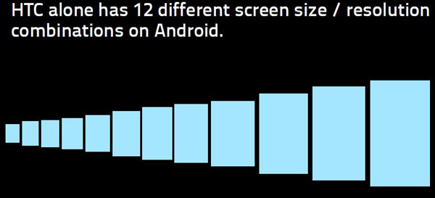
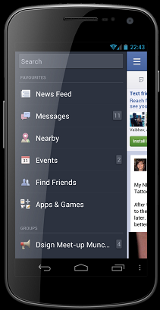
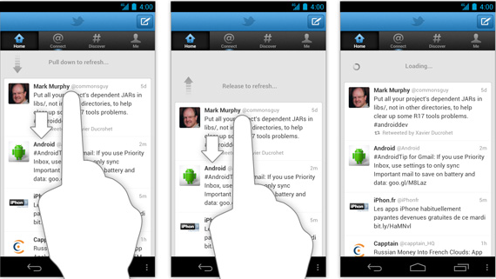
Universal Interfaces
Side Navigation Bar
Pull down to refresh

Slide 12
Software Reuse and Self-Adaptive Requirements
Software Reuse:-
Software of PC - Develop only for Windows.
Apps of Mobile – Develop for Website + iOS + Android + Windows + Black-Berry + others mobile Operating Systems.
Need for Self Adaptive Requirements:-
Battery life
Processor speeds
Front camera
Display size
Location of device
Fluctuating power levels
In Android:- SDK’s take care of most issues for making apps.
Future of Software Engineering:-
Make those software which commonly work in
Mobile + Desktop + Tablet.

